Slide 1
DATA ANALYSIS ON MLB BASEBALL LEAGUE
Christopher Ospina
Eva Montoya Davis
Genius Machado
Sharanya Dave
Analysis of MLB matches is done using python packages like pandas, matplotlib and seaborn.

Slide 2
INTRODUCTION
Big data has had a significant impact on the game of baseball in recent years. The use of statistical analysis, also known as sabermetrics, has become more prevalent in the sport, and teams are increasingly using data to make decisions.
Analyzing all the previous years' data is helpful not only to the players, but also to the team, Teams can use data to identify promising young players in high school, college, or foreign leagues. They can also use data to evaluate players in other teams' minor league systems, and to identify potential trade targets.
United States is the biggest baseball market, but it is not limited to it. So, people tend to spend a lot of money to see their heroes in action in a live match. It's no secret that watching a game live is vastly different from watching it on television. Through the sale of tickets and broadcasting rights to TV stations, these organizations make their profits.

Slide 3
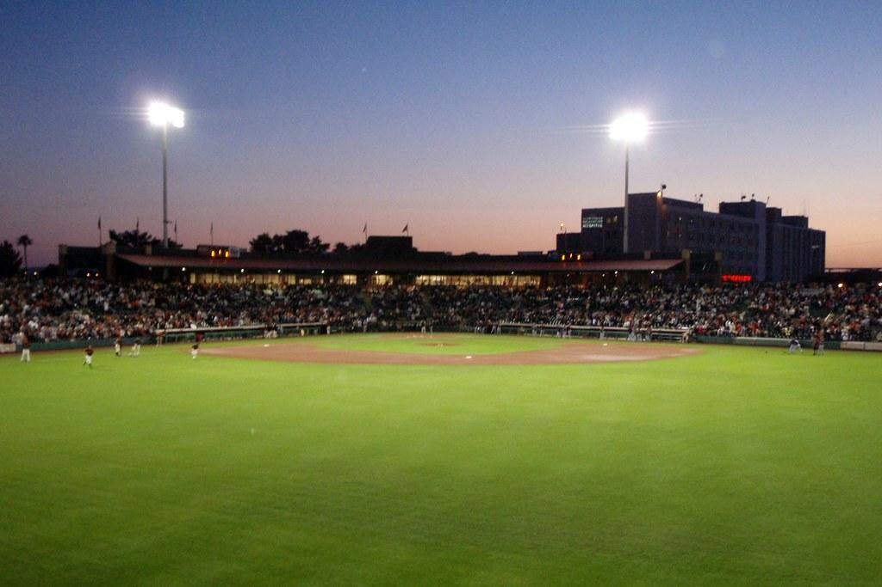
ABOUT BASEBALL
Baseball is a sport played between two teams of nine players each, with the objective of scoring runs by hitting a ball thrown by a pitcher and running around a series of bases laid out in a diamond-shaped field. The team with the most runs at the end of the game, typically nine innings, wins the game.
Baseball is often referred to as "America's national pastime" and has a rich history and culture in the United States. It is also played in other countries around the world, with different variations of the game.

Slide 4
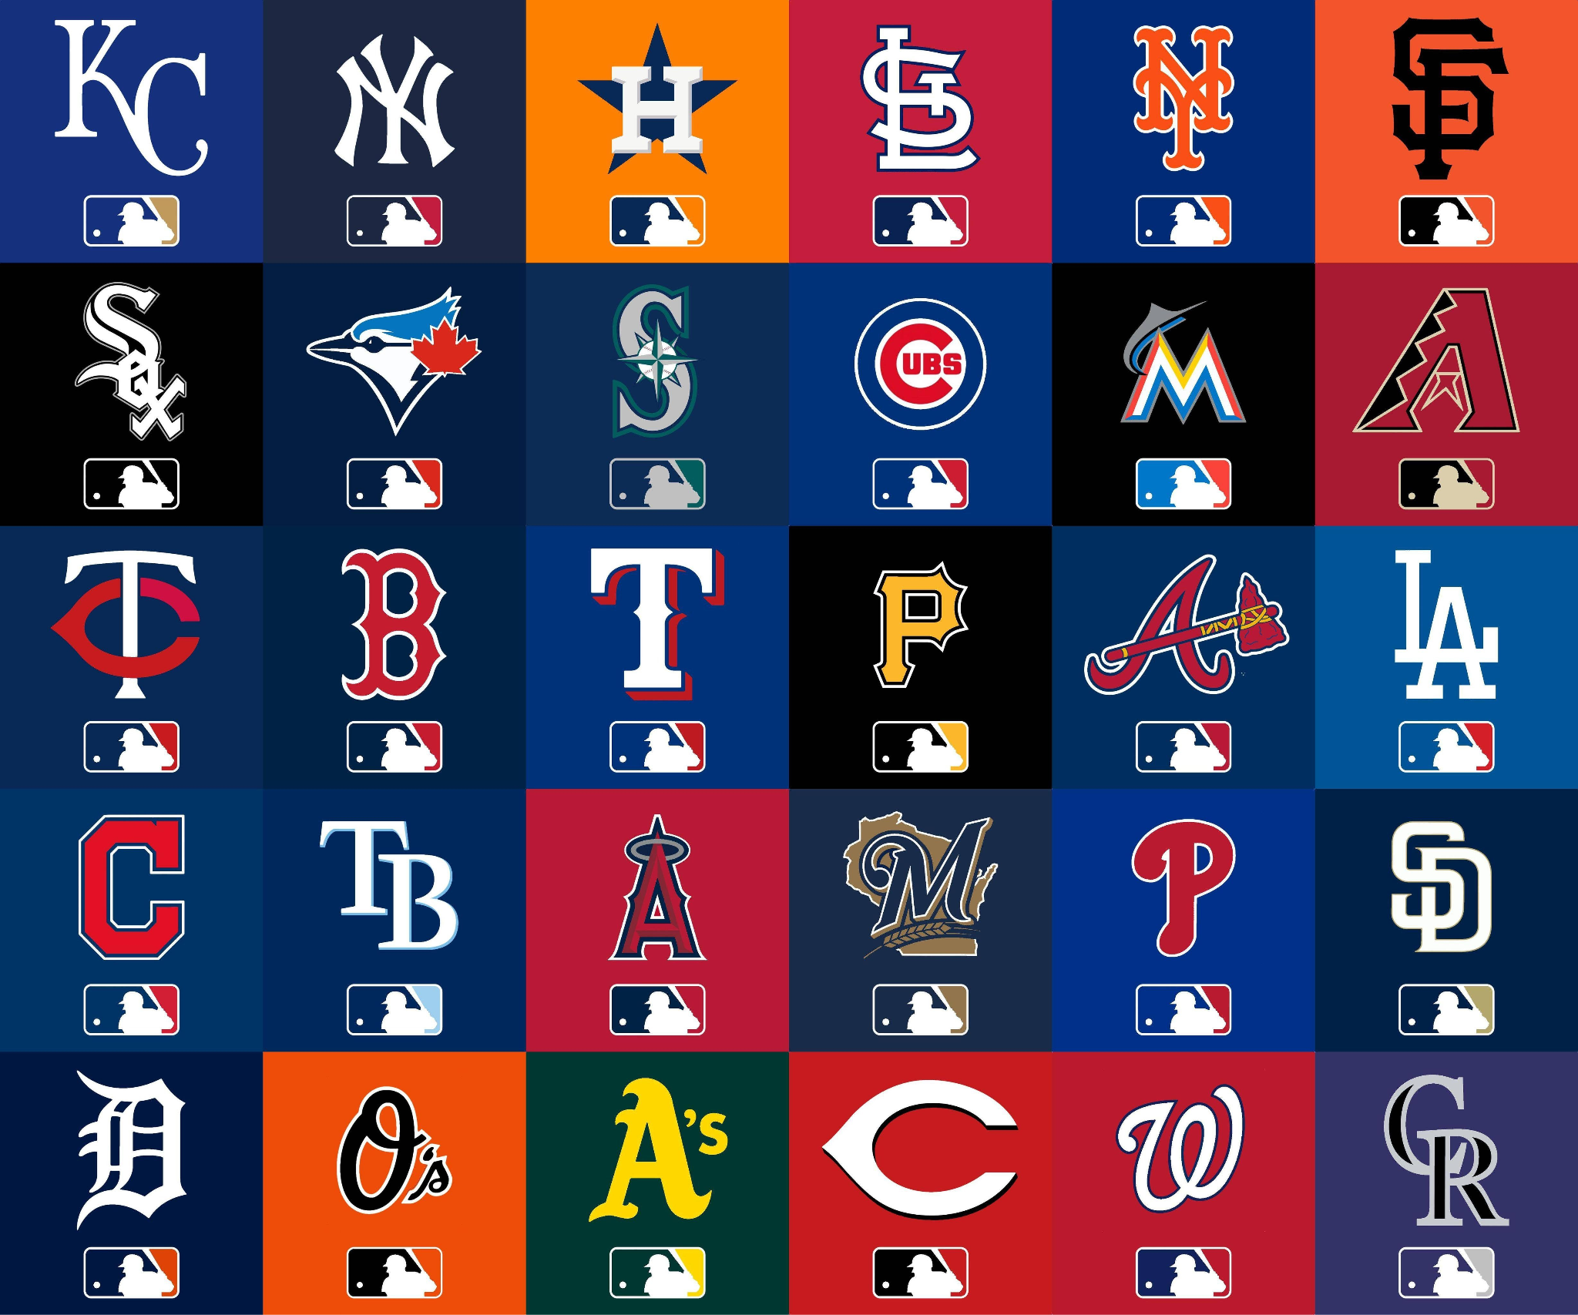
MLB : Major League Baseball
MLB is the highest level of professional baseball in the United States and Canada. It consists of two leagues: The National League (NL) and the American League (AL), each with 15 teams.
The MLB is one of the most popular and lucrative sports leagues in the world, with a large fan base and high-profile media coverage.

Slide 5
Problem Statement
We have conducted an exploratory data analysis on two different datasets, for the purpose of determining what factors may have an impact on a team's chances of winning. The factors we chose to analyze are as follows: Win rate, number of games played, result of the toss, and the venue. We were also curious to know about additional factors, such as: highest performing players.

Slide 6

DATA VISUALIZATION LIBRARIES AND DATASETS
This Python notebook uses Python packages such as pandas, matplotlib, and seaborn to analyze MLB matches The dataset that we use in this notebook are Baseball Matches From 2008-2020 and Baseball Ball-to-Ball Data From 2008-2020.

Slide 7
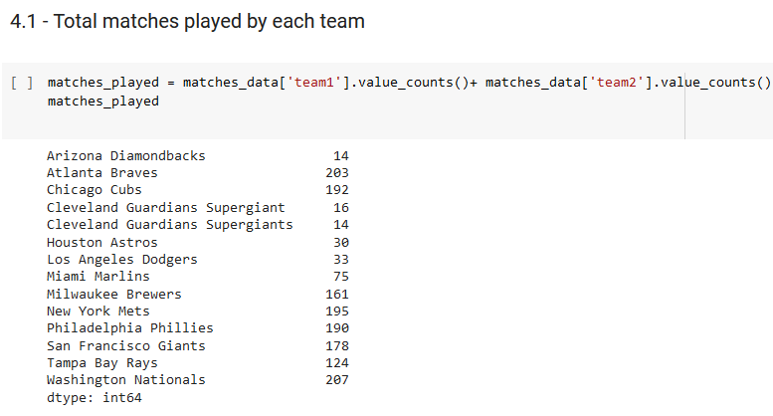
Total Matches Played By Each Team
This Image shows the number of matches won by each team over the years in a tabular form.

Slide 8
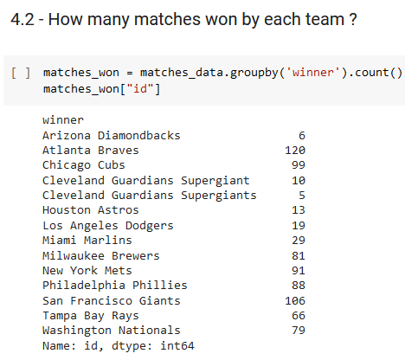
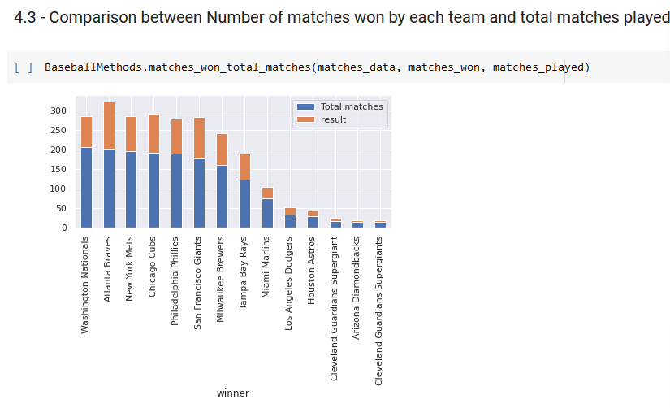
Comparison Between Number of Matches WON By Each Team and Total Matches Played

Slide 9
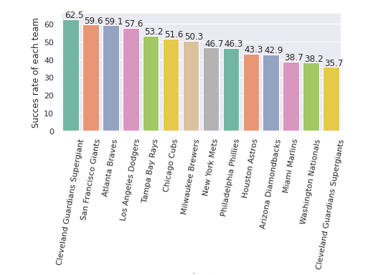
Success Rate Of Each Team
In this graph, we can see that the Cleveland Guardians have the highest winning success rate of 62.5, followed by San Francisco giants. without doing a full statistical analysis, it seems clear that the teams that play more games tend to have a higher win percentage.

Slide 10
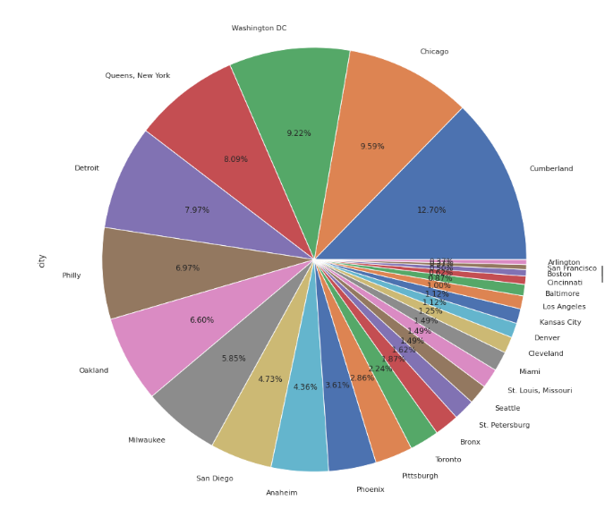
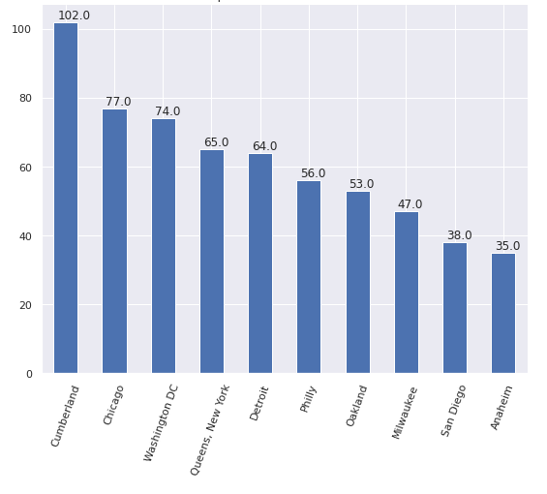
Top 10 Cities to hold Match
Cumberland had held highest number of matches (102) followed by Chicago (77)

Slide 11
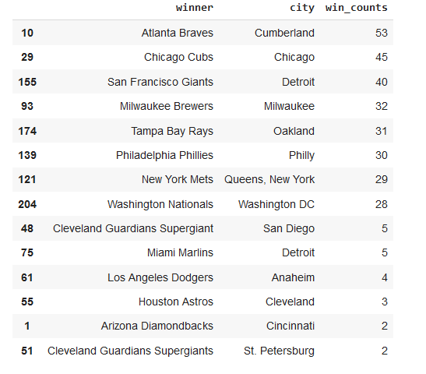
The City in Which Maximum Matches are WON
In the image it can be seen that Teams have won more matches in their home grounds

Slide 12
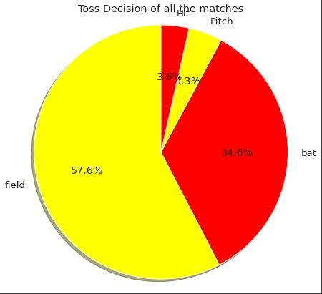
Toss Decision across Matches
From the Image we see that 57.6% of the toss winning teams chose Fielding first while the other 34.6% chose Batting first.

Slide 13
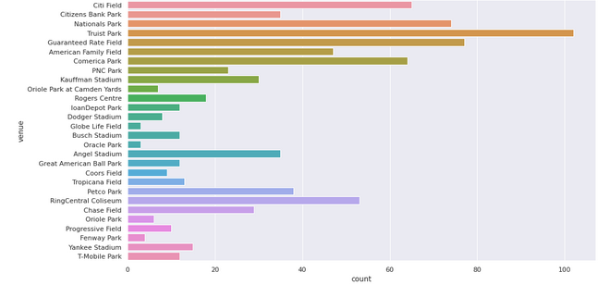
Most Venues to Hold Match
In the image the graph shows that Truist Park has held highest number of matches followed by Guaranteed Rate Field

Slide 14
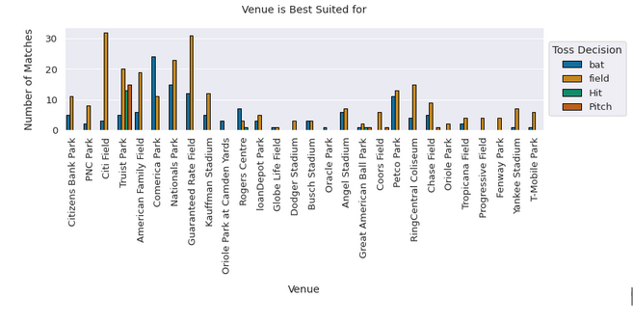
Citi Field Stadium and Guaranteed Rate Field Stadium are best suited for Fielding and Comerica Park is best suited for Batting.

Slide 15
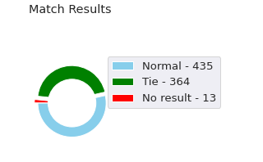
Match Result
We Can See in this Graph the Match Result which is Normal Matches-435,Tie Matches - 364 AND No Result-13

Slide 16
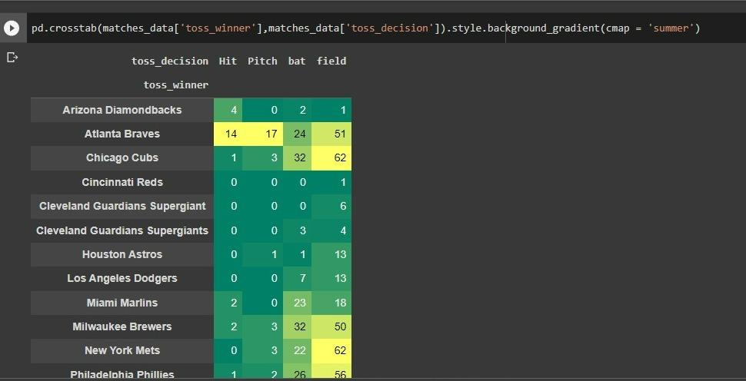
Toss Winner VS Toss Decision
The teams who won toss also are the one won most of the matches

Slide 17
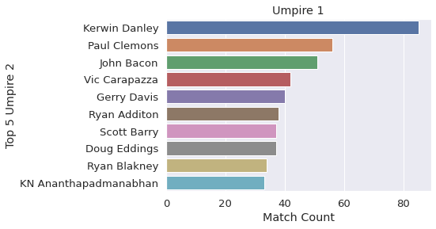
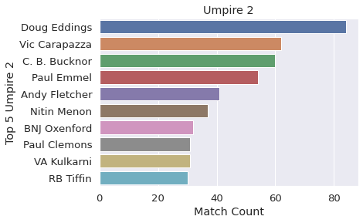
TOP 5 UMPIRES IN THE FIELD

Slide 18
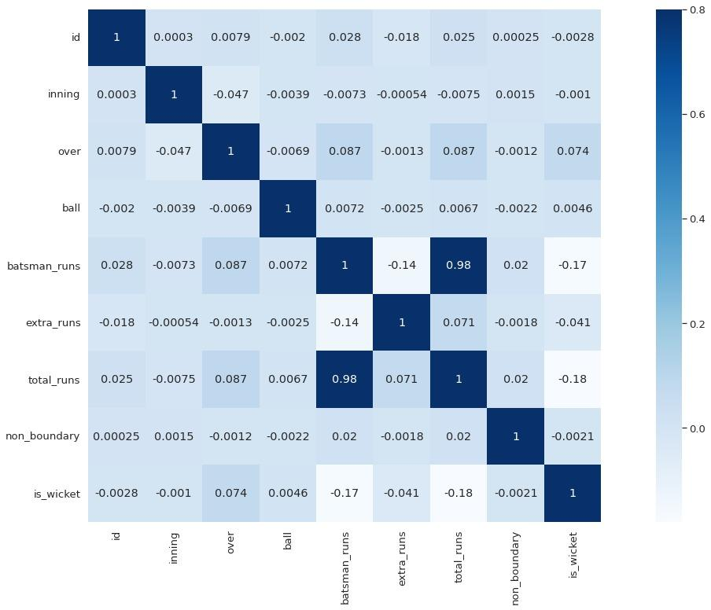
The image represents the correlation present in the Ball-by-Ball dataset. Each square in the image indicates the correlation between the variables on the respective axes. Values close to zero indicate the absence of a linear trend between the two variables. A correlation closer to 1 suggests a stronger positive correlation between the variables. The correlation strength is denoted by the size and color intensity of the number, with larger and darker numbers representing higher correlation between the variables.

Slide 19
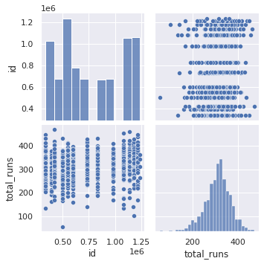
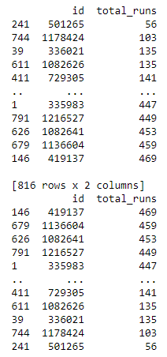
Data Visualization for Most Runs Scored

Slide 20
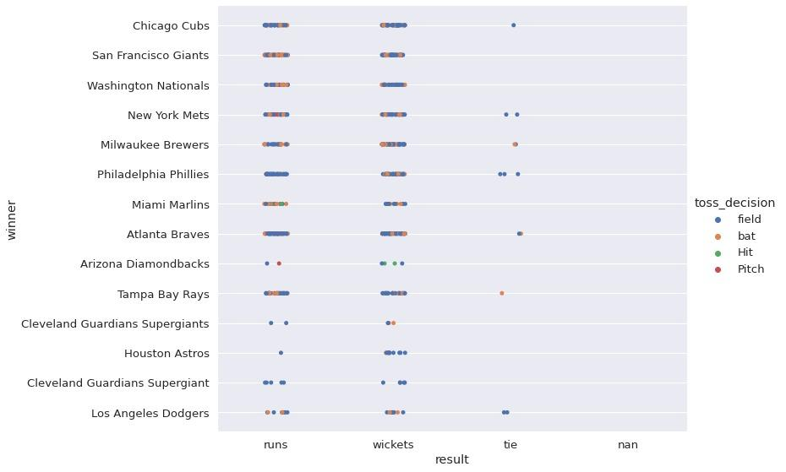
catplot for the teams that won match and the toss as well
THE CODE IS :
sns.catplot(x="result", y="winner", hue="toss_decision", data=matches_data, height=8, aspect=1.5)

Slide 21
RESULTS
* The success rate of Cleveland Guardians is good competitively among the new teams.
* New York Mets and San Francisco Giants are best defending team.
* From the year 2014 most of the teams are opting to field after winning the toss and are also successful in winning matches.
* Overall San Francisco Giants and New York Mets have high success rate.
* From the analysis we can see that San Francisco Giants and New York Mets are more likely to win upcoming BaseBall seasons.

Slide 22
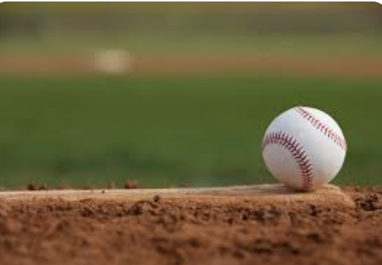
Conclusion
After considering all of these factors, we discovered a probable association between the number of games played and the number of games won. Furthermore, winning the coin toss at the start of each game appears to benefit the team. These findings are only a small portion of the data analysis conducted on this data set; there are numerous other insights that we can gain from past data. Therefore, it is possible to envision how such data analysis, when applied by the team management and event organizers, can help identify weaknesses and improve operational efficiency.

